Slide 1
Introduction

Slide 2
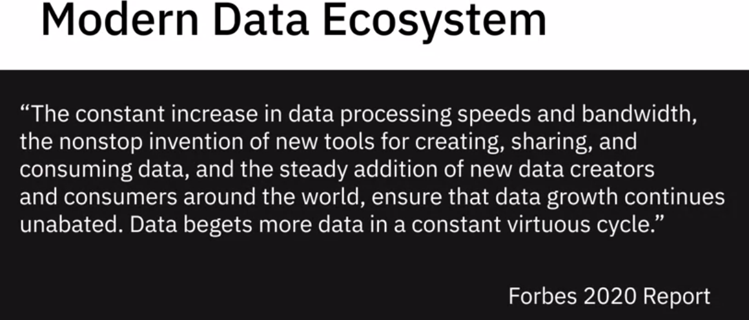
1. Modern data ecosystem

Slide 3
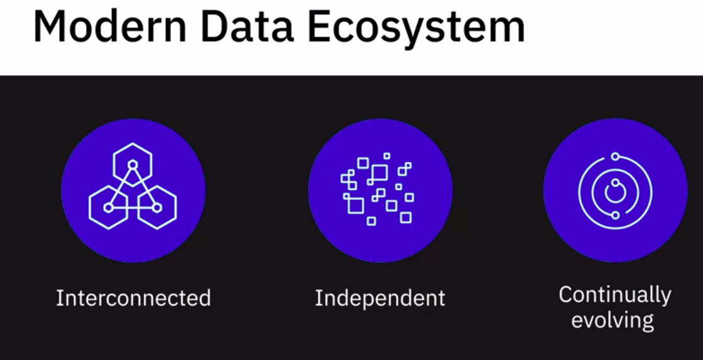
1. Modern data ecosystem
Notes:
A modern data ecosystem includes a whole network of interconnected, independent, and continually evolving entities.

Slide 4
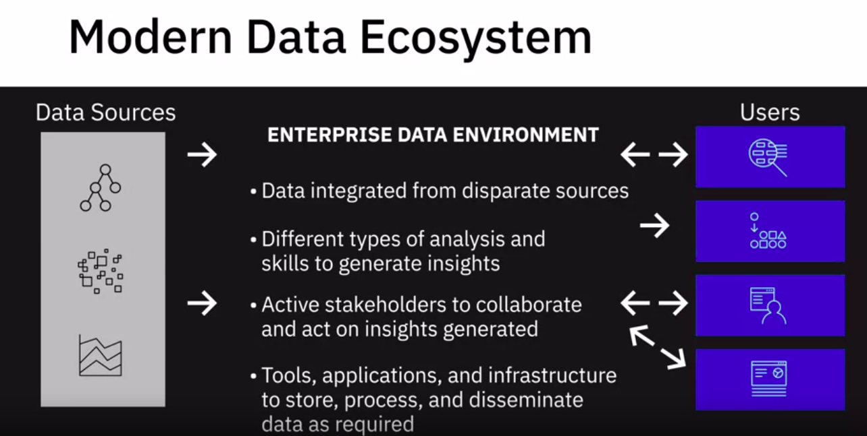
1. Modern data ecosystem
Notes:
It includes data that has to be integrated from disparate sources;
different types of analysis and skills to generate insights;
active stakeholders to collaborate and act on insights generated;
and tools, applications, and infrastructure to store, process, and disseminate data as required.

Slide 5
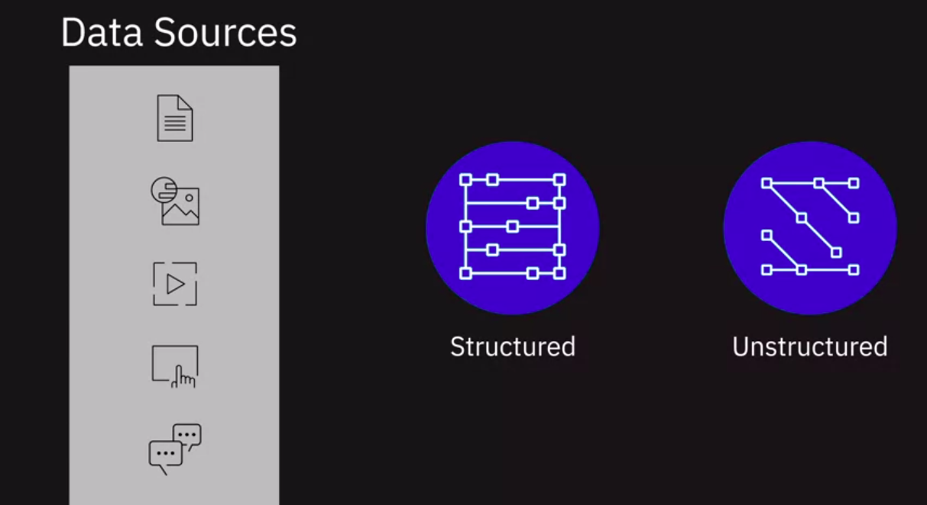
1. Modern data ecosystem - Data sources
Notes:
Data is available in a variety of structured and unstructured datasets, residing in text, images, videos, clickstreams, user conversations, social media platforms, the Internet of Things
(or IoT) devices, real-time events that stream data, legacy databases, and data sourced from professional data providers and agencies.

Slide 6
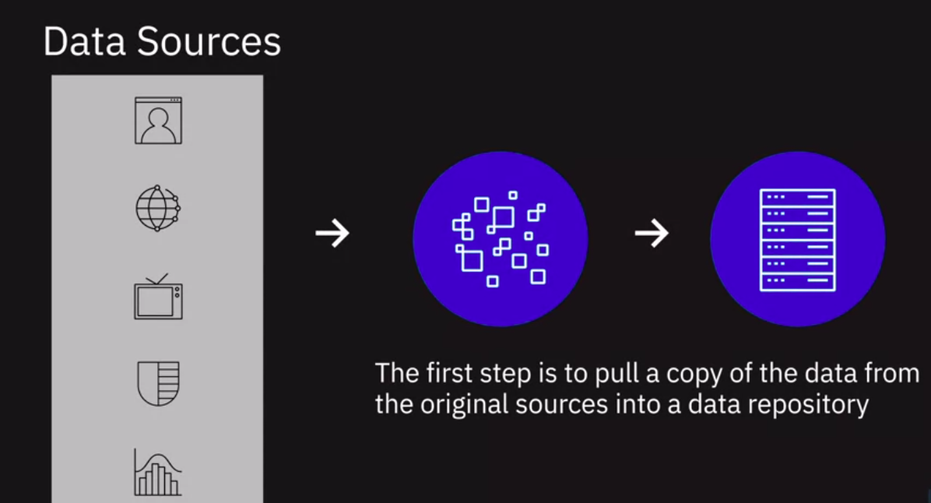
1. Modern data ecosystem - Data sources
Notes:
When you’re working with so many different sources of data, the first step is to pull a copy of the data from the original sources into a data repository.

Slide 7
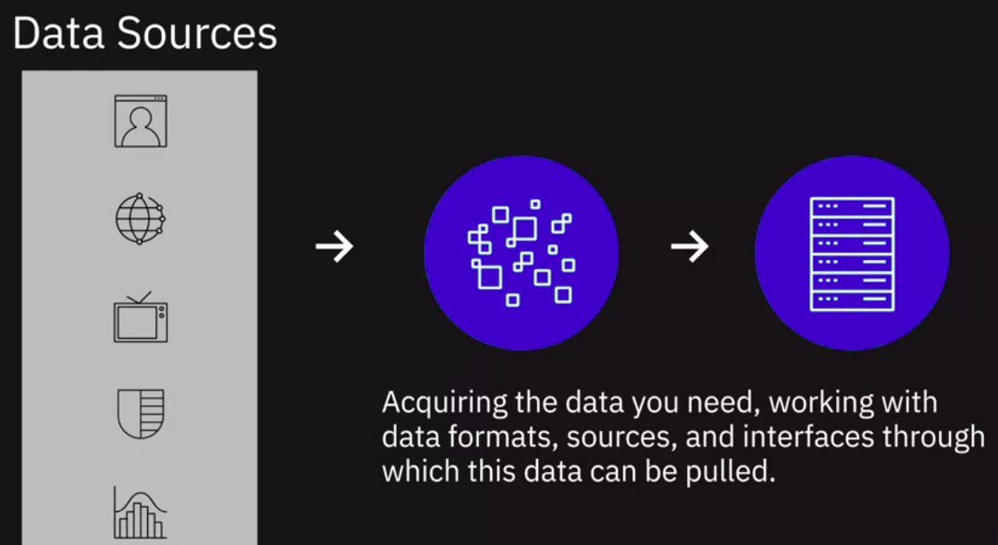
1. Modern data ecosystem - Data sources
Notes:
At this stage, you’re only looking at acquiring the data you need—working with data formats, sources, and interfaces through which this data can be pulled in.

Slide 8
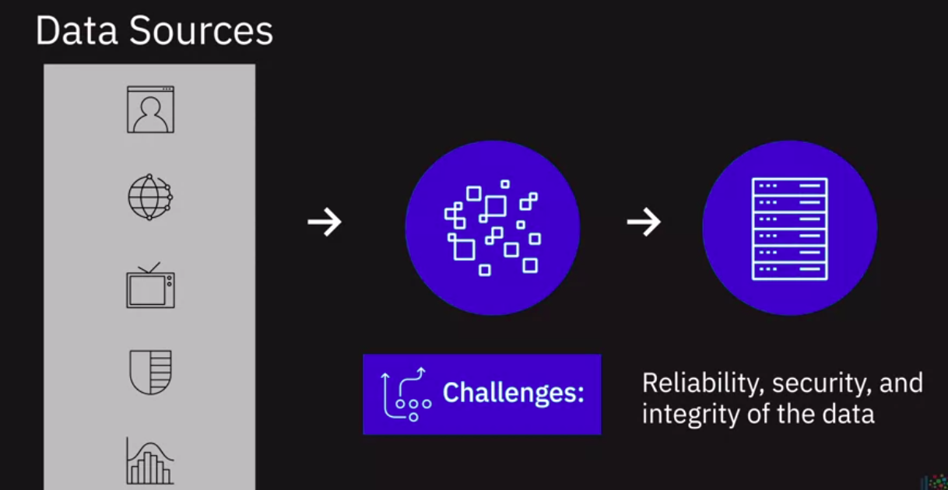
1. Modern data ecosystem - Data sources
Notes:
Reliability, security, and integrity of the data being acquired are some of the challenges you work through at this stage.

Slide 9
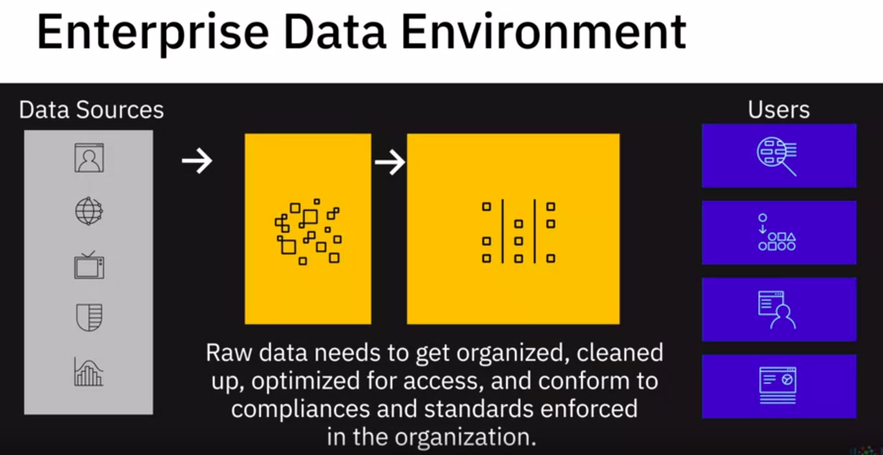
1. Modern data ecosystem - Enterprise data environment
Notes:
Once the raw data is in a common place, it needs to get organized, cleaned up, and optimized for access by end-users.
The data will also need to conform to compliances and standards enforced in the organization.
For example, conforming to guidelines that regulate the storage and use of personal data such as health, biometrics, or household data in the case of IoT devices.

Slide 10
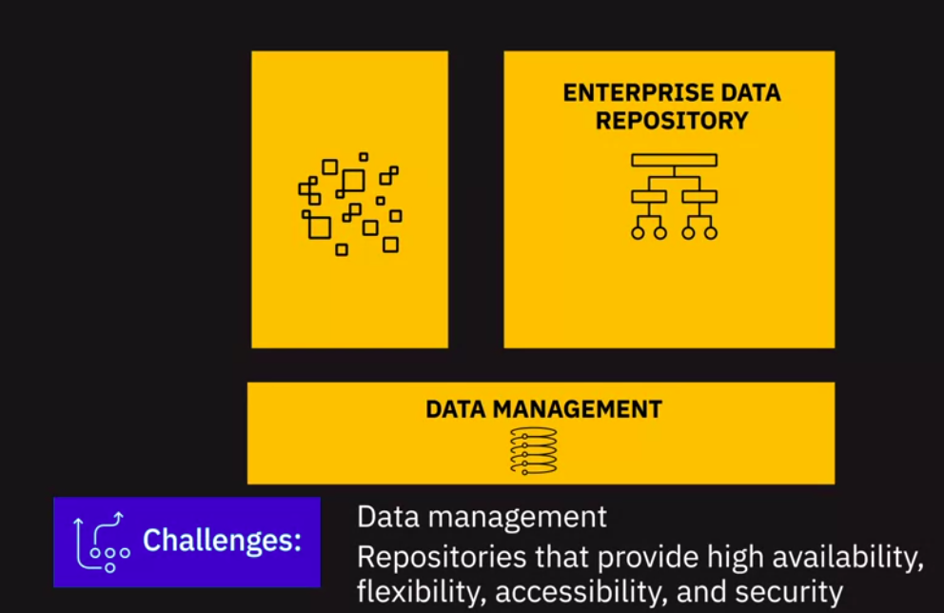
1. Modern data ecosystem - Enterprise data environment
Notes:
Adhering to master data tables within the organization, to ensure standardization of master data across all applications and systems of an organization, is another example.
The key challenges at this stage could involve data management and working with data repositories that provide high availability, flexibility, accessibility, and security.

Slide 11
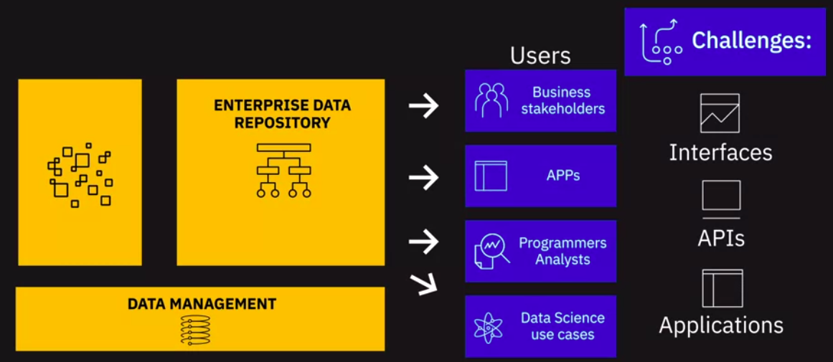
1. Modern data ecosystem - Users
Notes:
Finally, we have our business stakeholders, applications, programmers, analysts, and data science use cases all pulling this data from the enterprise data repository.
The key challenges at this stage could include the interfaces, APIs, and applications that can get this data to the end-users in line with their specific needs.
For example, Data Analysts may need the raw data to work with, business stakeholders may need reports and dashboards, applications may need custom APIs to pull this data.

Slide 12
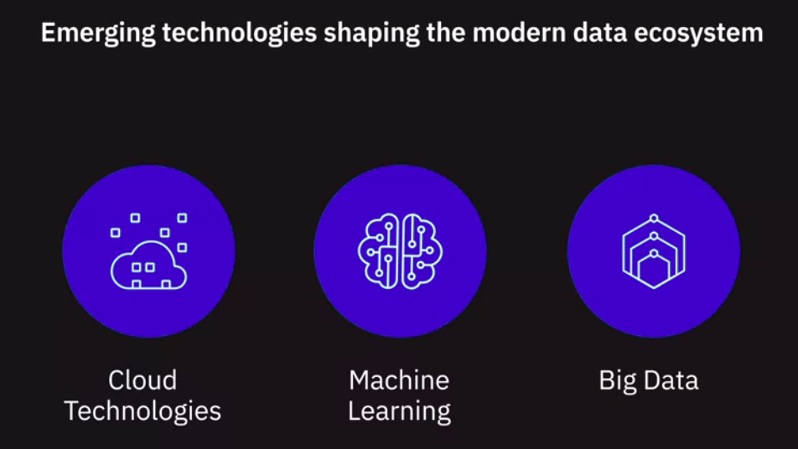
1. Modern data ecosystem

Slide 13
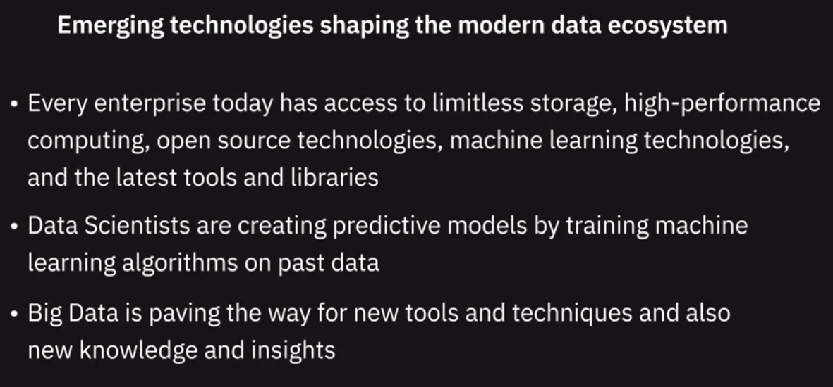
1. Modern data ecosystem
Notes:
Today, organizations that are using data to uncover opportunities and are applying that knowledge to differentiate themselves are the ones leading into the future.
Whether looking for patterns in financial transactions to detect fraud, using recommendation engines to drive conversion, mining social media posts for customer voice, or brands
personalizing their offers based on customer behavior analysis, business leaders realize that data holds the key to competitive advantage.

Slide 14
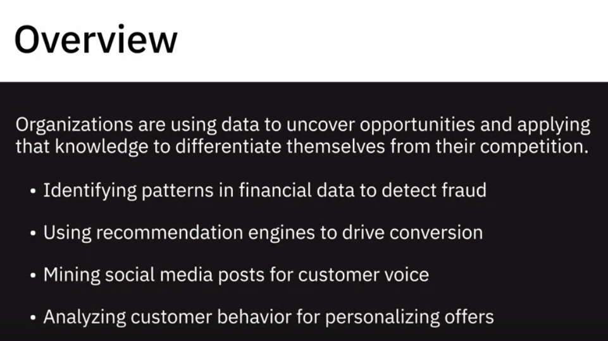
2. Key players in Data ecosystem

Slide 15
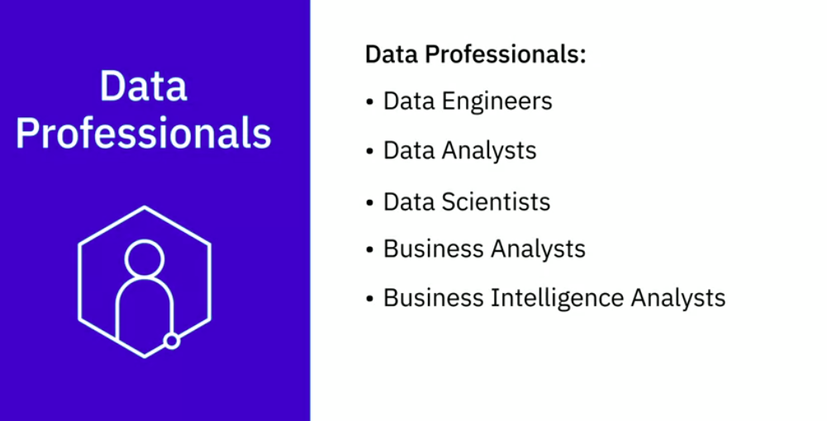
2. Key players in Data ecosystem

Slide 16
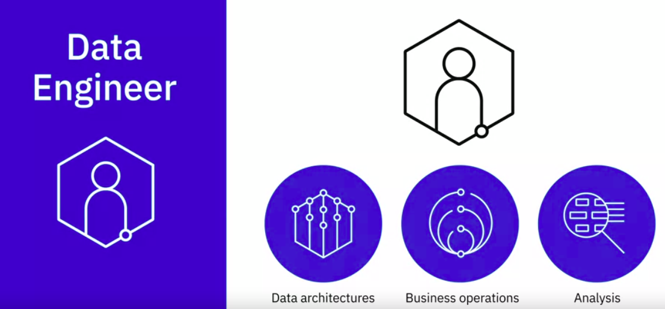
2. Key players in Data ecosystem - Data engineer
Data Engineers are people who develop and maintain data architectures and make data available for business operations and analysis

Slide 17
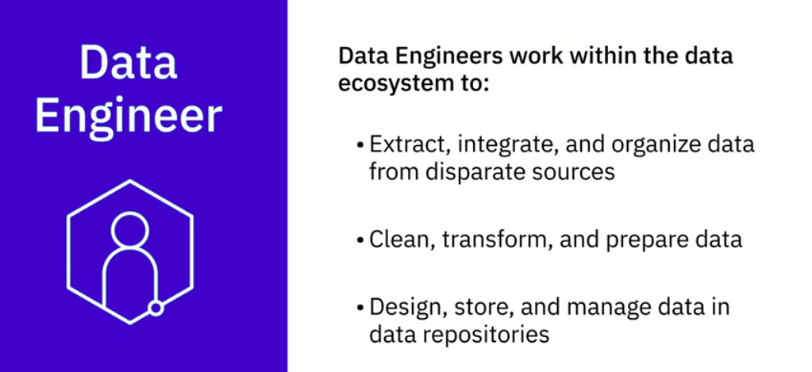
2. Key players in Data ecosystem - Data engineer

Slide 18
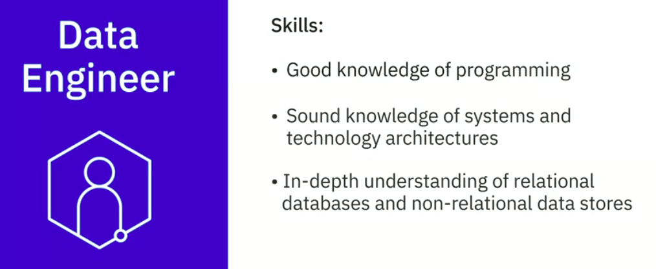
2. Key players in Data ecosystem - Data engineer

Slide 19
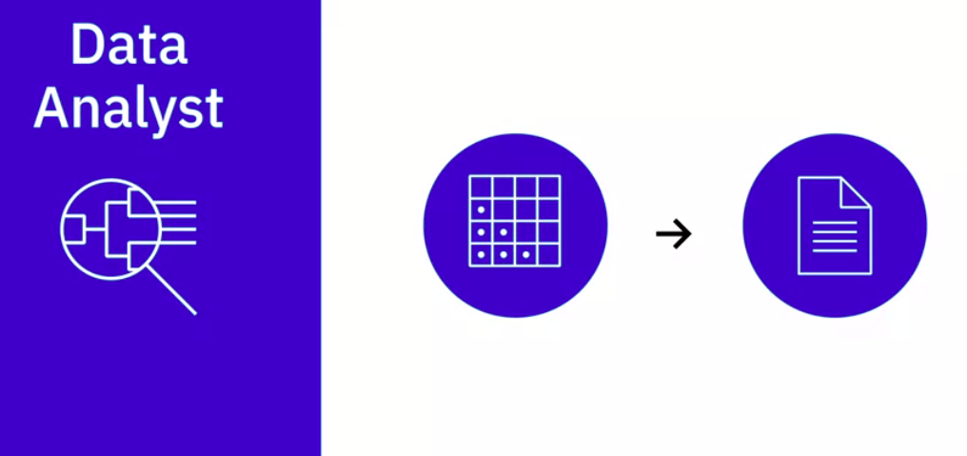
2. Key players in Data ecosystem - Data Analyst
Data Analyst translates data and numbers into plain language, so organizations can make decisions

Slide 20
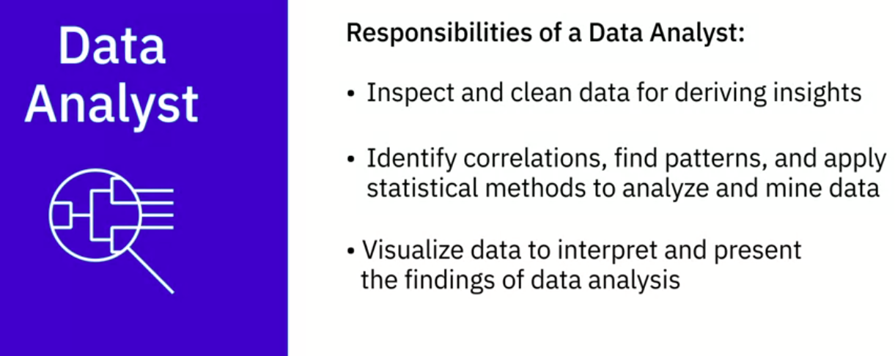
2. Key players in Data ecosystem - Data Analyst

Slide 21
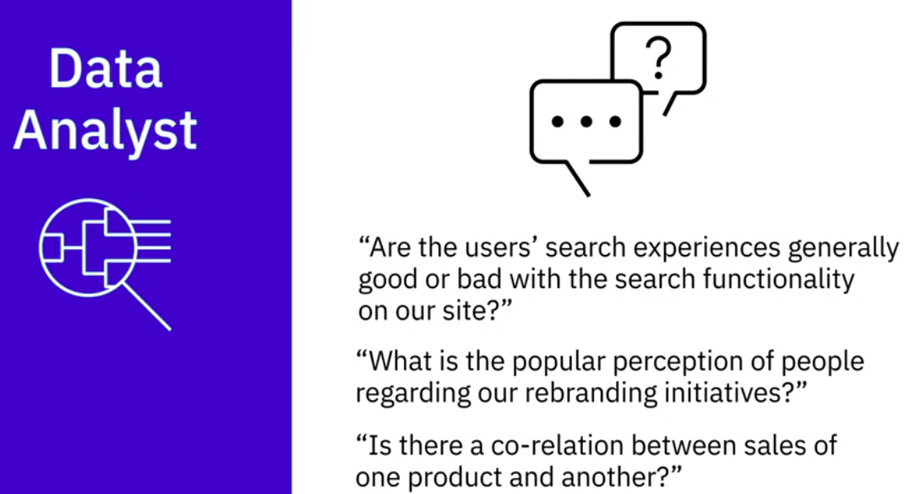
2. Key players in Data ecosystem - Data Analyst

Slide 22
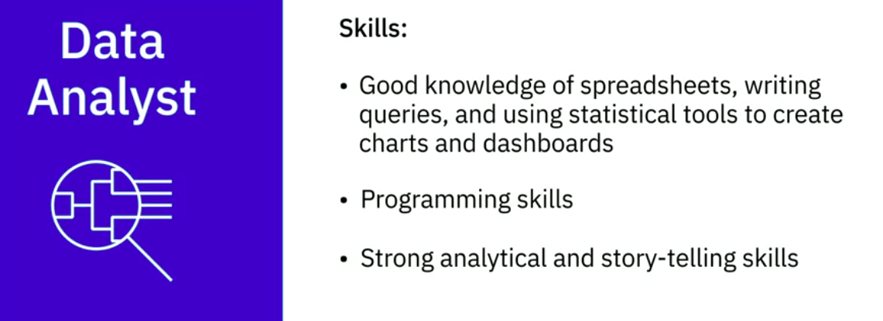
2. Key players in Data ecosystem - Data Analyst

Slide 23
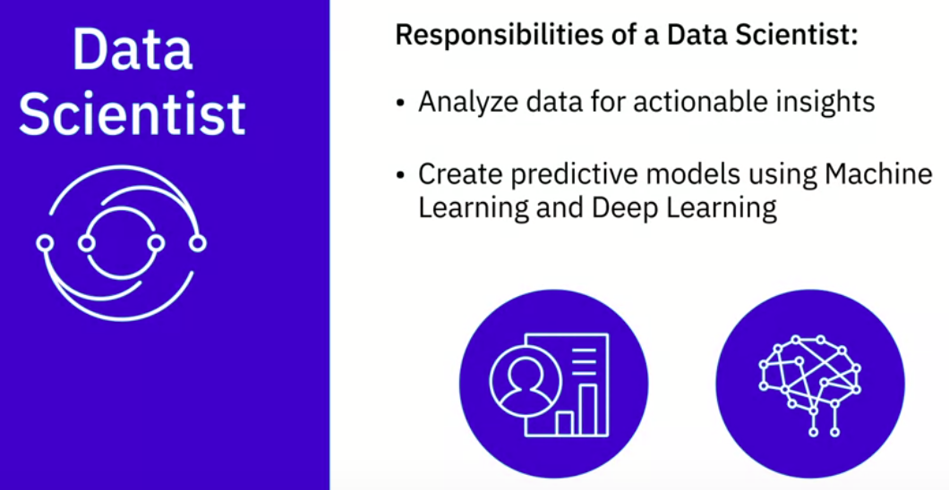
2. Key players in Data ecosystem - Data Scientist

Slide 24
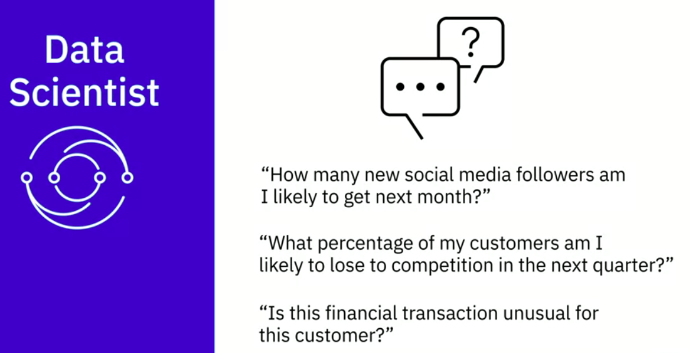
2. Key players in Data ecosystem - Data Scientist

Slide 25
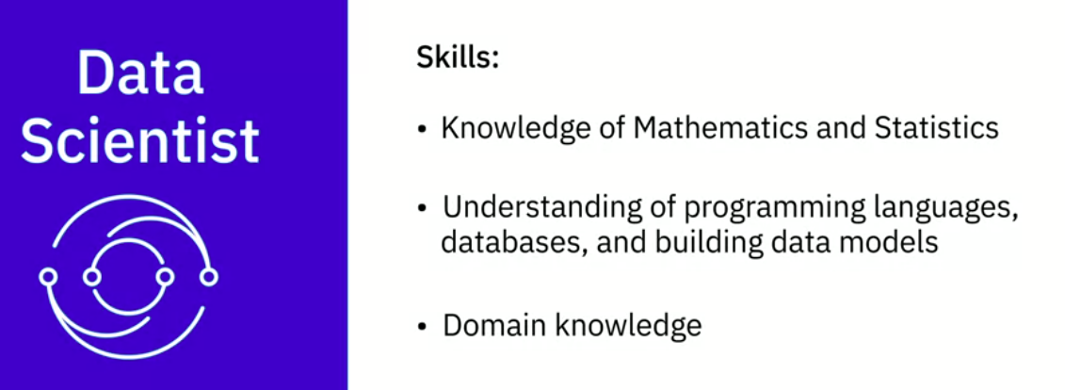
2. Key players in Data ecosystem - Data Scientist

Slide 26
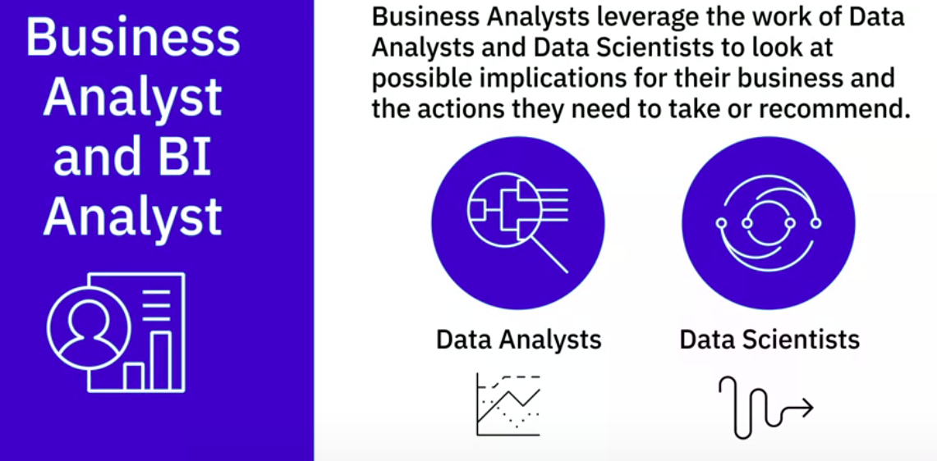
2. Key players in Data ecosystem - BI analyst

Slide 27
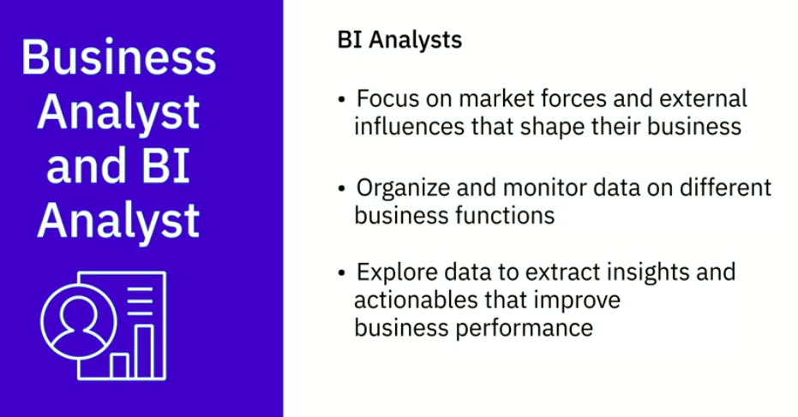
2. Key players in Data ecosystem - BI analyst

Slide 28
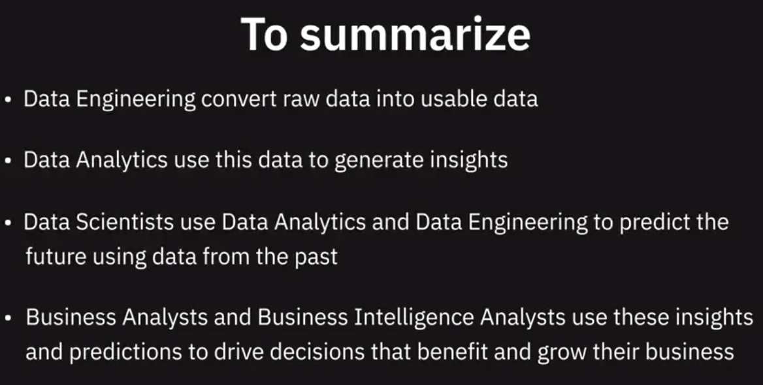
2. Key players in Data ecosystem - Summary

Slide 29
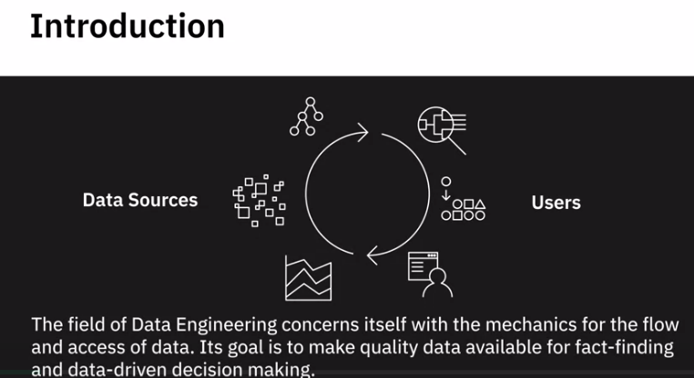
3. What is DE - Introduction

Slide 30
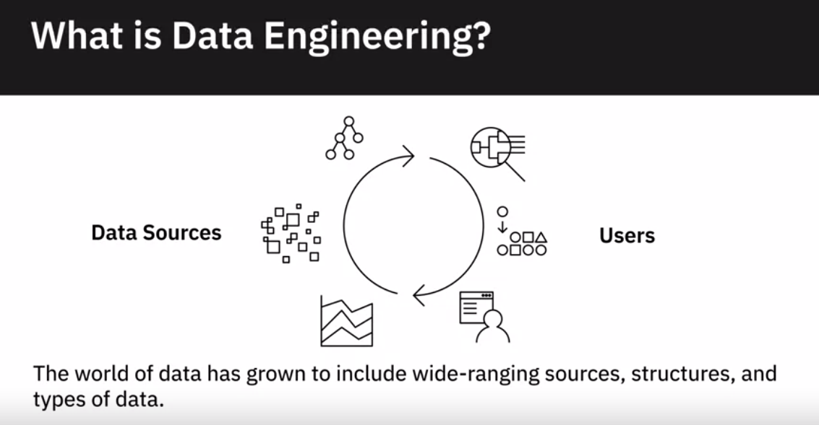
3. What is DE - Introduction

Slide 31
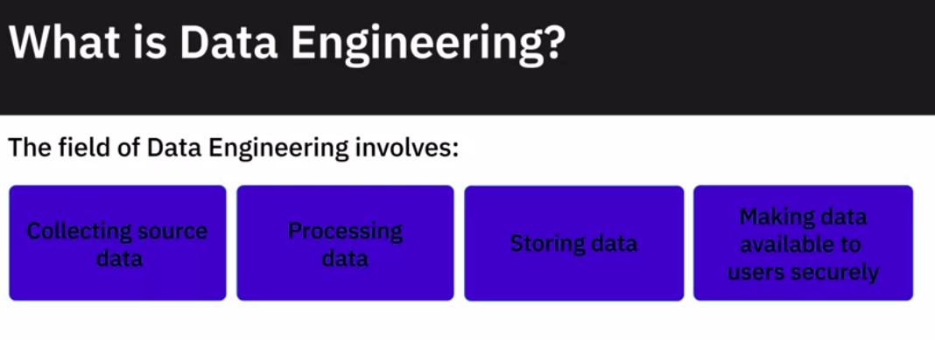
3. What is DE - fields of DE

Slide 32
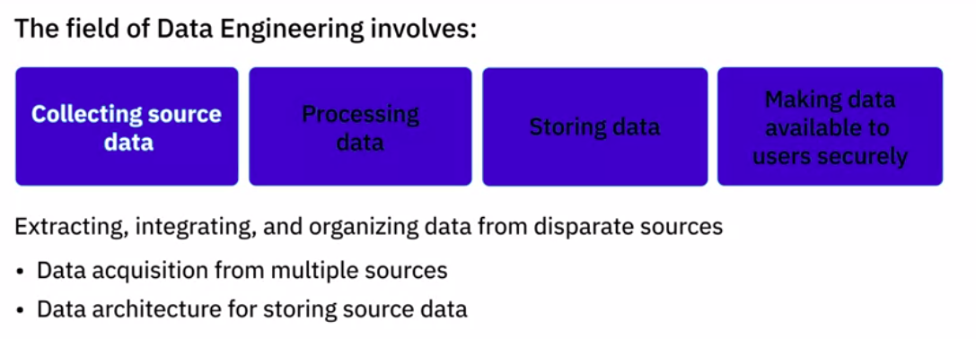
3. What is DE - fields of DE
Develop tools, workflows, and processes that help you acquire data from multiple sources. Design, build, and maintain scalable data architecture to store data. Data could be stored in databases, data warehouses, data lakes, or any other type of data repository

Slide 33
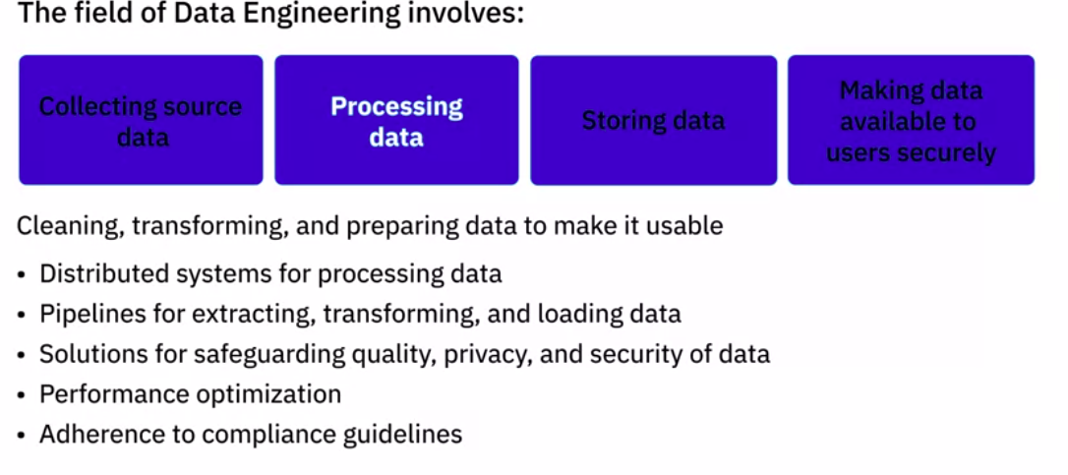
3. What is DE - fields of DE
Implement and maintain distributed systems for large-scale processing of data. Design pipelines for the extraction, transformation, and loading of data into data repositories. Design or implement solutions for validating and safeguarding quality, privacy, and security of data. Optimize tools, systems, and workflows for performance, reliability, and scalability. Ensure data meets all regulatory and compliance guidelines.

Slide 34
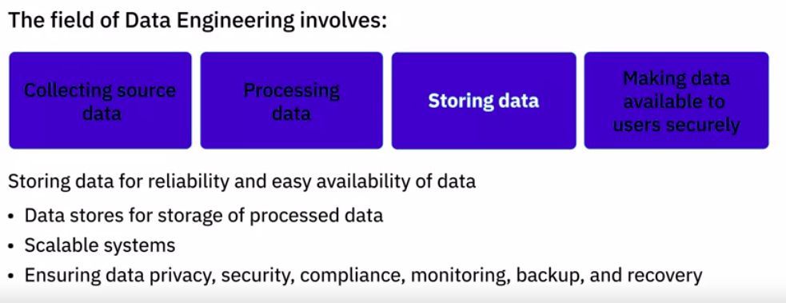
3. What is DE - fields of DE
Architect or implement data stores for the storage of processed data. Ensure systems are scalable, keeping in mind the evolving nature of data and business needs. Ensure tools and systems are in place that take care of data privacy, security, compliance, monitoring, backup, and recovery.

Slide 35
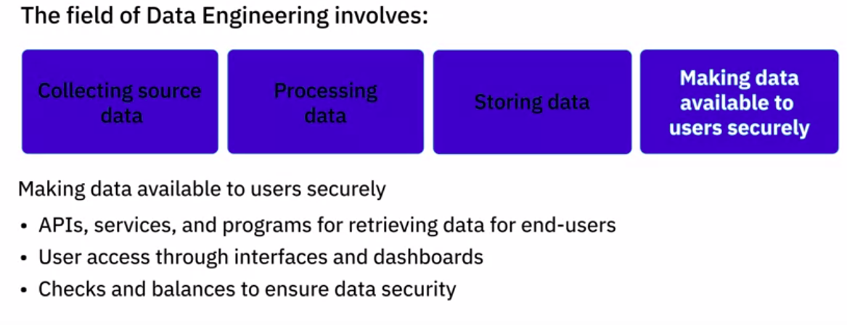
3. What is DE - fields of DE
APIs, services, and programs that retrieve data on defined parameters for use by end-users. Interfaces and dashboards that present data to users so they can derive insights from the data. Ensure the right measures and checks and balances are in place to keep data secure and provide rights-based access to users

Slide 36
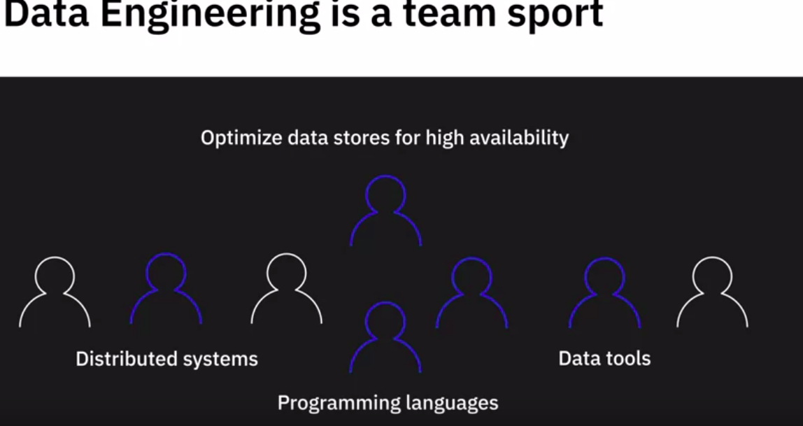
3. What is DE

Slide 37
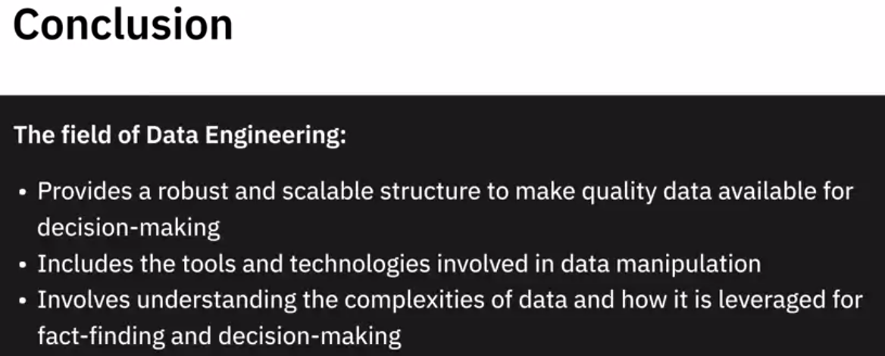
3. What is DE - Conclusion

Slide 38
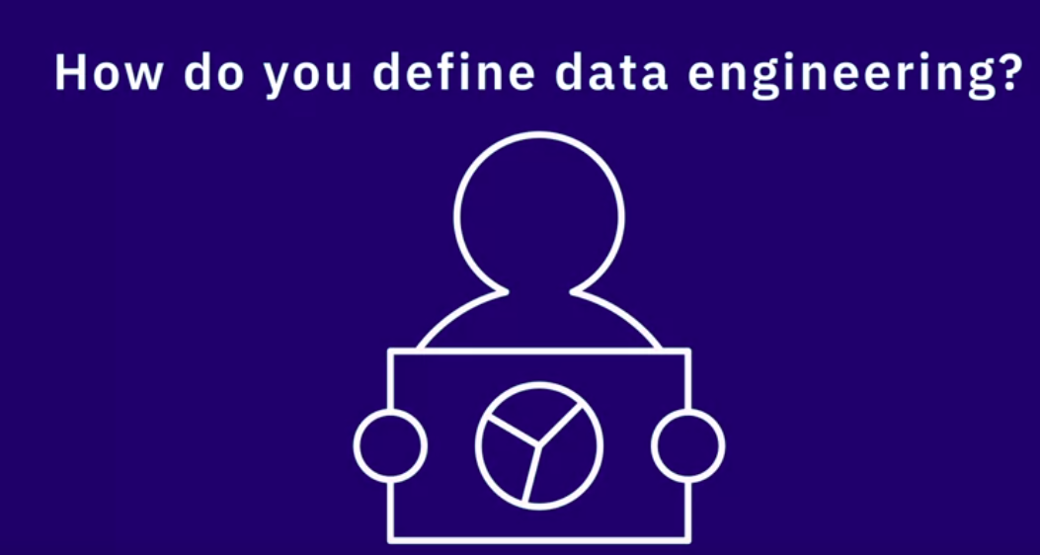
4. Defending data engineering
we will listen to several data professionals talk about how they define data engineering and how it differs from data analytics and data science.

Slide 39
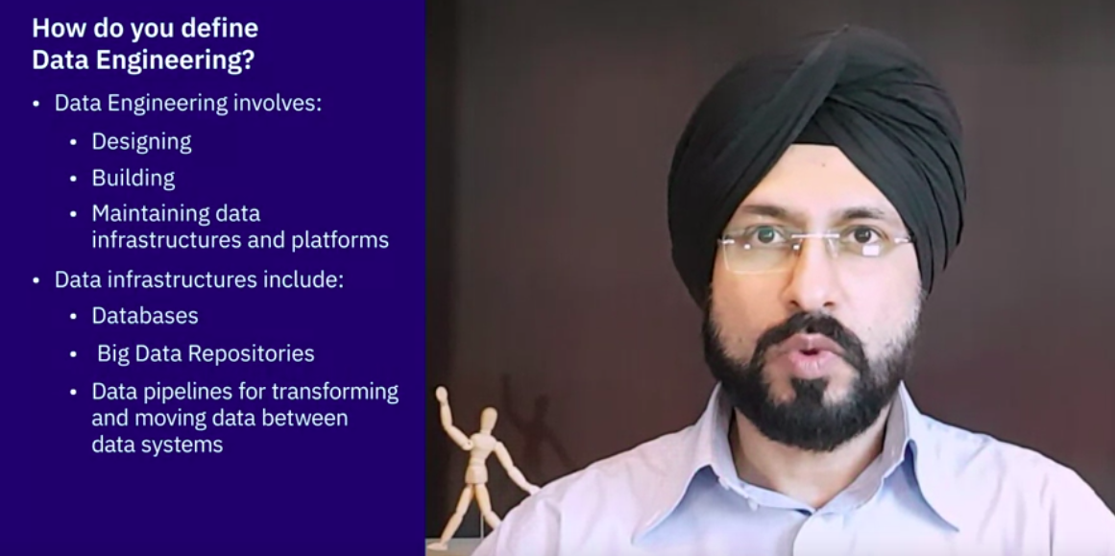
4. Defending data engineering

Slide 40
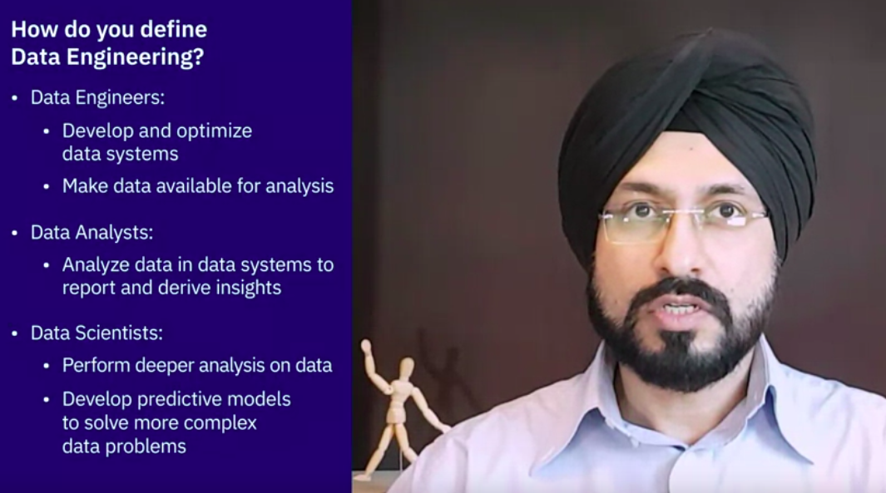
4. Defending data engineering

Slide 41
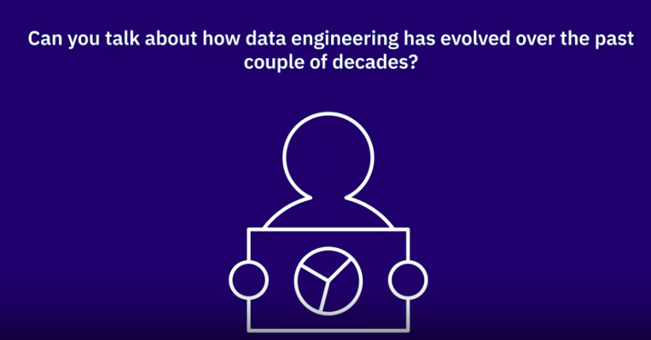
5. Evolution of Data engineering

Slide 42
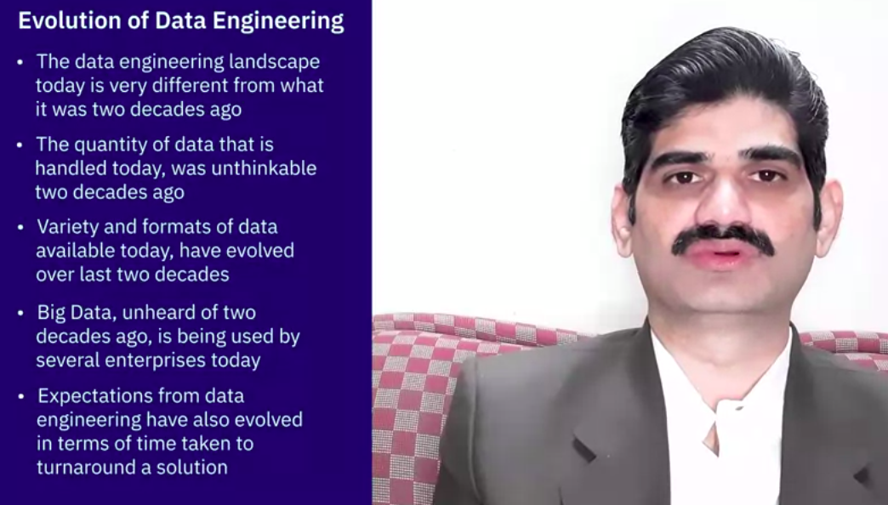
5. Evolution of Data engineering

Slide 43
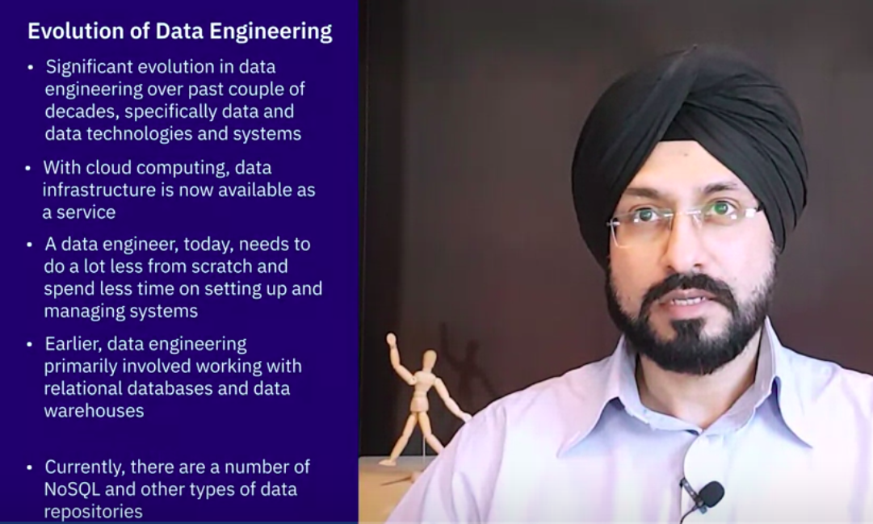
5. Evolution of Data engineering

Slide 44
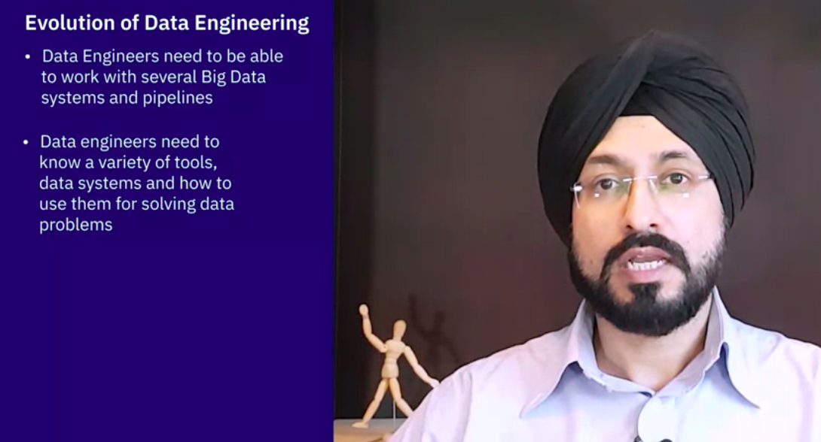
5. Evolution of Data engineering

Slide 45
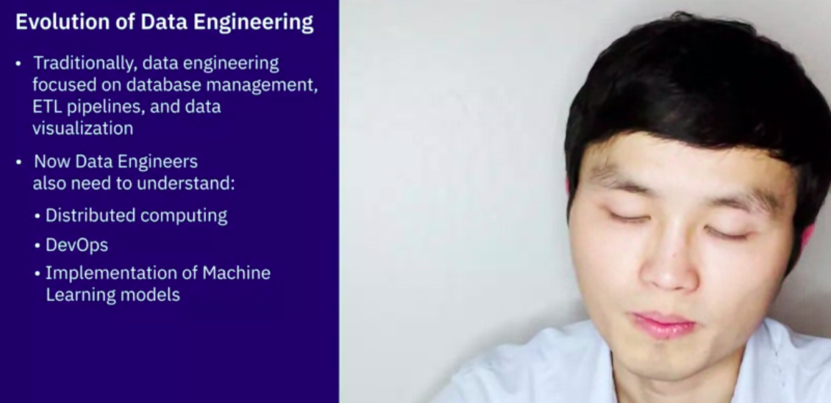
5. Evolution of Data engineering

Slide 46
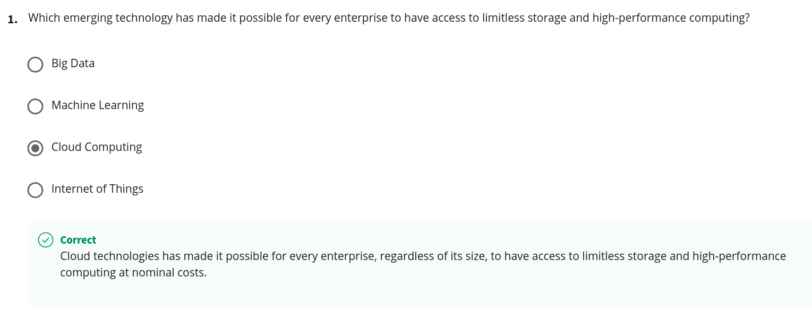
Quiz

Slide 47
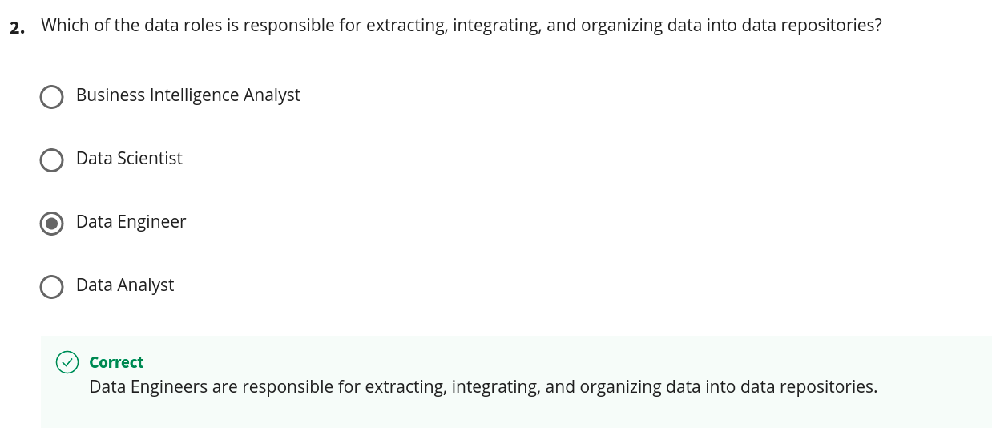
Quiz

Slide 48
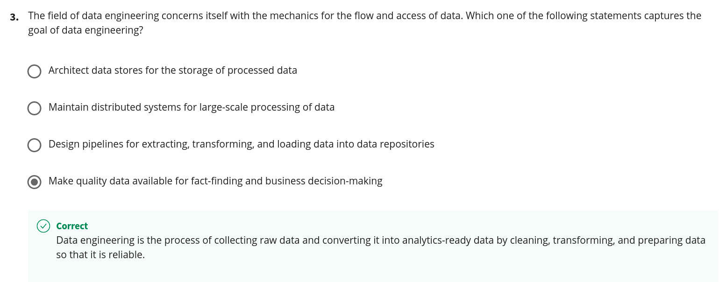
Quiz

Slide 49
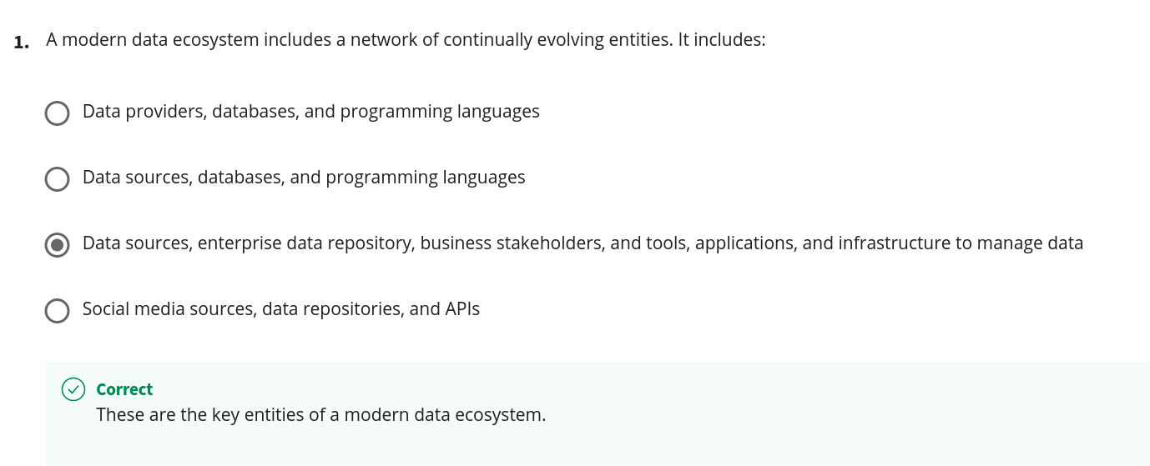
Quiz

Slide 50
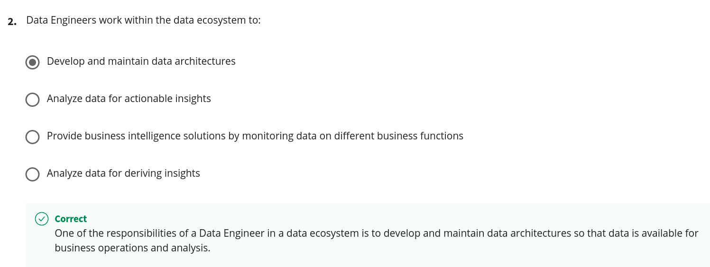
Quiz

Slide 51
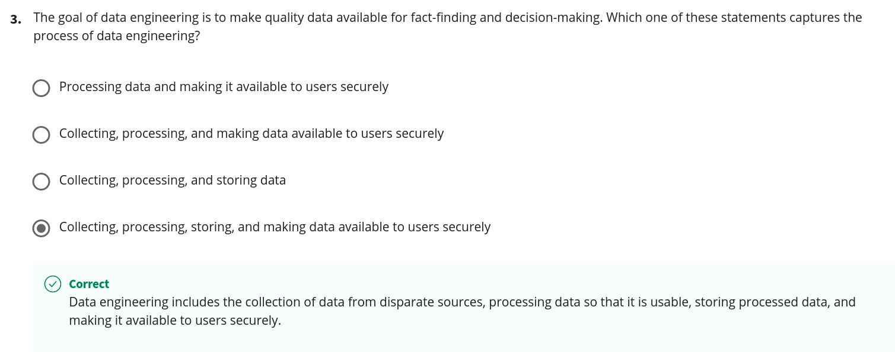
Quiz

Slide 52

Quiz

Slide 53

Quiz

Slide 54

6. Responsibilities and skillsets of Data Engineer

Slide 55

6. Responsibilities

Slide 56

6. Responsibilities

Slide 57

6. Technical skills

Slide 58

6. Technical skills
application services, such as load balancing and application performance monitoring

Slide 59

6. Technical skills
RDBMS: Relationship Database Magenetment System

Slide 60

6. Technical skills

Slide 61

6. Technical skills
Experience of working with ETL tools such as IBM Infosphere Information Server, AWS Glue, and Improvado

Slide 62

6. Technical skills

Slide 63

6. Technical skills

Slide 64

6. Functional skills

Slide 65

6. Functional skills

Slide 66

6. Functional skills

Slide 67

6. Soft skills

Slide 68

6. Responsibilities and skillsets of Data Engineer - Conclusion

Slide 69

6. View points from professionals

Slide 70

6. View points from professionals

Slide 71

6. View points from professionals

Slide 72

Quiz

Slide 73

Quiz

Slide 74

Quiz

